Slide 1


Pablo Ramos
07/04/2023

Slide 2

Outline
Executive Summary
Introduction
Methodology
Results
Conclusion
Appendix

Slide 3
Executive Summary
Summary of methodologies
Data Collection: Web scraping and SpaceX API
Exploratory Data Analysis (EDA): Data wrangling, data visualization, interactive visual analytics
Machine Learning Prediction
Results Summary:
Collected valuable data from public sources
EDA identified best features for predicting launch success
Machine Learning Prediction determined the best model for leveraging collected data

Slide 4
Introduction
Goal:
Assess the potential of Space Y to rival SpaceX
• Key Insights Needed:
Forecasting total launch expenses through successful first stage rocket landings predictions
Determining the optimal site for conducting launches

Slide 5

Section 1

Slide 6
Methodology
Executive Summary
Method for gathering data:
Acquired Space X data from two distinct resources:
Space X API (https://api.spacexdata.com/v4/rockets/)
Web Scraping (https://en.wikipedia.org/wiki/List_of_Falcon/_9/_and_Falcon_Heavy_launches)
Conduct data manipulation
Enhanced the collected data by generating a landing result label from outcome information after examining and summarizing attributes
Carry out exploratory data analysis (EDA) employing visualizations and SQL

Slide 7
Methodology
Executive Summary
Carry out interactive visual analysis with Folium and Plotly Dash
Execute predictive assessments employing classification algorithms
Up to this stage, gathered data was standardized, separated into training and testing datasets, and assessed with four distinct classification techniques. Each model's accuracy was measured using various parameter combinations

Slide 8
Data Collection
Information was obtained from a pair of sources: Space X API (https://api.spacexdata.com/v4/rockets/rockets/) and Wikipedia (https://en.wikipedia.org/wiki/List_of_Falcon/_9/_and_Falcon_Heavy_launches), employing web scraping methods.

Slide 9
Data Collection – SpaceX API
SpaceX provides an accessible API for data acquisition and utilization;
Following the adjacent flowchart, the API was employed, and the data was stored.
Source code: https://github.com/bloramos/IBM-Applied-Data-Science-Capstone/blob/main/Data%20Collection%20API.ipynb
Parse data from SpaceX launch information via API request
Filter data to only include Falcon 9 launches
Replace Missing values

Slide 10
Data Collection - Scraping
Information on SpaceX launches can be sourced from Wikipedia
Data is retrieved following the flowchart and subsequently stored.
Source code:https://github.com/bloramos/IBM-Applied-Data-Science-Capstone/blob/main/Data%20Collection%20with%20Web%20Scraping.ipynb
Parse data from SpaceX launch information via Wiki page
Obtain all column/attribute names from the HTML table header
Construct a data frame by processing the launch HTML tables

Slide 11
Data Wrangling
At first, Exploratory Data Analysis (EDA) was conducted on the dataset.
Next, calculations were made for the number of launches per site, frequency of each orbit, and mission outcomes for each orbit type.
Ultimately, the landing outcome label was derived from the Outcome column.
Source code: https://github.com/bloramos/IBM-Applied-Data-Science-Capstone/blob/main/Data%20Wrangling.ipynb
EDA
Summarizations
Creation
of
Landing
Outcome Label

Slide 12
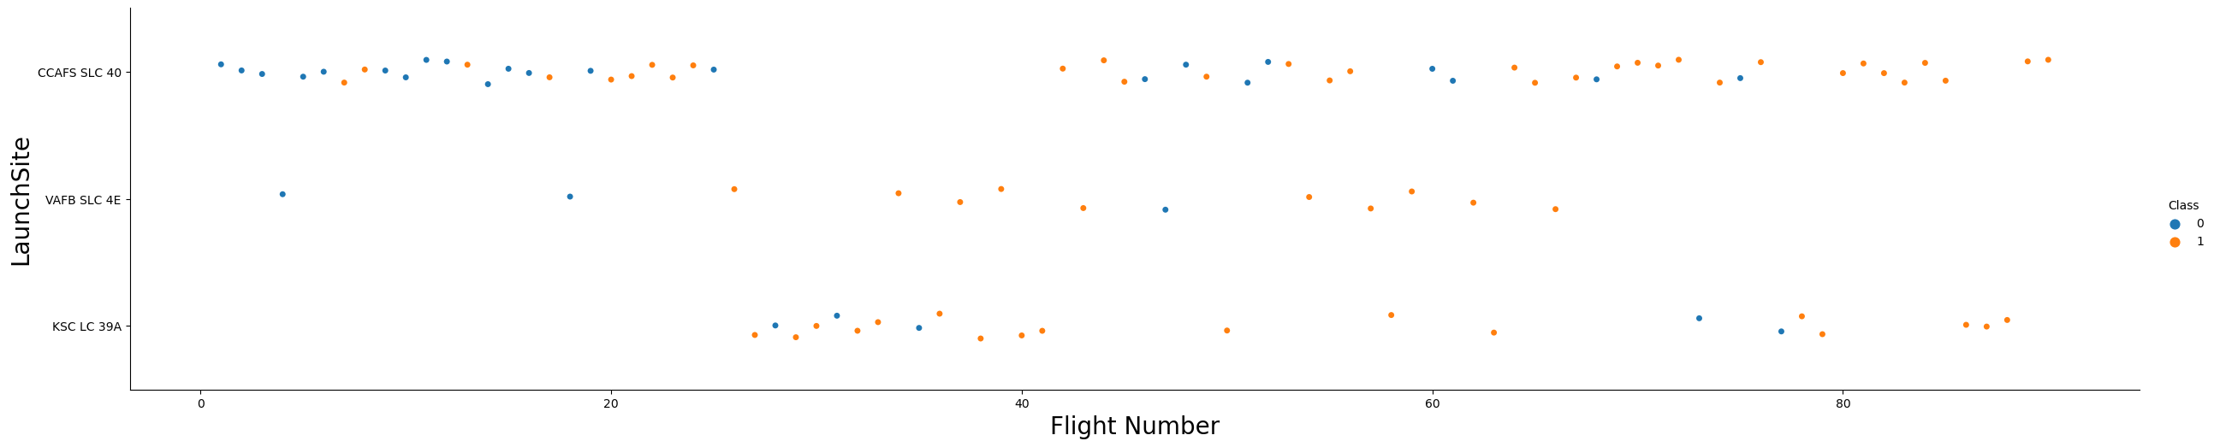
EDA with Data Visualization
For data exploration, scatterplots and barplots were employed to display the connections between pairs of attributes:
Payload Mass vs. Flight Number, Launch Site vs. Flight Number, Launch Site vs. Payload Mass, Orbit and Flight Number, Payload and Orbit.
Source code: https://github.com/bloramos/IBM-Applied-Data-Science-Capstone/blob/main/EDA%20with%20Data%20Visualization.ipynb

Slide 13
EDA with SQL
SQL queries performed:
Names of the unique launch sites in the space mission;
Top 5 launch sites whose name begin with the string 'CCA’;
Total payload mass carried by boosters launched by NASA (CRS);
Average payload mass carried by booster version F9 v1.1;
Date when the first successful landing outcome in ground pad was achieved;
Names of the boosters which have success in drone ship and have payload mass between 4000 and 6000 kg;
Total number of successful and failure mission outcomes;
Names of the booster versions which have carried the maximum payload mass;
Failed landing outcomes in drone ship, their booster versions, and launch site names for in year 2015; and
Rank of the count of landing outcomes (such as Failure (drone ship) or Success (ground pad)) between the date 2010-06-04 and 2017-03-20.
Source code: https://github.com/bloramos/IBM-Applied-Data-Science-Capstone/blob/main/EDA.ipynb

Slide 14
Build an Interactive Map with Folium
Using Folium Maps, the following elements were employed:
Markers, which pinpoint locations such as launch sites;
Circles, highlighting areas surrounding specific coordinates, like NASA Johnson Space Center
Marker clusters, representing groups of events at each coordinate, like launches at a launch site; and
Lines, utilized for illustrating distances between two coordinates.
Source code: https://github.com/bloramos/IBM-Applied-Data-Science-Capstone/blob/main/Interactive%20Visual%20Analytics%20with%20Folium%20lab.ipynb

Slide 15
Build a Dashboard with Plotly Dash
Various graphs and plots were employed for data visualization:
Proportion of launches per site
Payload spectrum
This combination facilitated swift analysis of the relationship between payloads and launch sites, aiding in determining the optimal location for launches based on payload requirements.
Source code: https://github.com/bloramos/IBM-Applied-Data-Science-Capstone/blob/main/spacex_dash_app.py

Slide 16
Predictive Analysis (Classification)
Four classification methods were evaluated: logistic regression, support vector machine, decision tree, and k-nearest neighbors.
Source code: https://github.com/bloramos/IBM-Applied-Data-Science-Capstone/blob/main/Machine%20Learning%20Prediction.ipynb
Preparation and standardization of data.
Evaluated models with varied hyperparameters
Results comparision

Slide 17
Results
Exploratory data analysis results:
Space X operates from 4 distinct launch sites;
Early launches were conducted for Space X and NASA;
F9 v1.1 booster has an average payload of 2,928 kg;
Successful landing outcomes began 5 years after the first launch in 2015;
Mission outcomes were successful in nearly 100% of cases;
Two booster versions, F9 v1.1 B1012 and F9 v1.1 B1015, failed to land on drone ships in 2015;
The rate of successful landing outcomes improved over time.

Slide 18
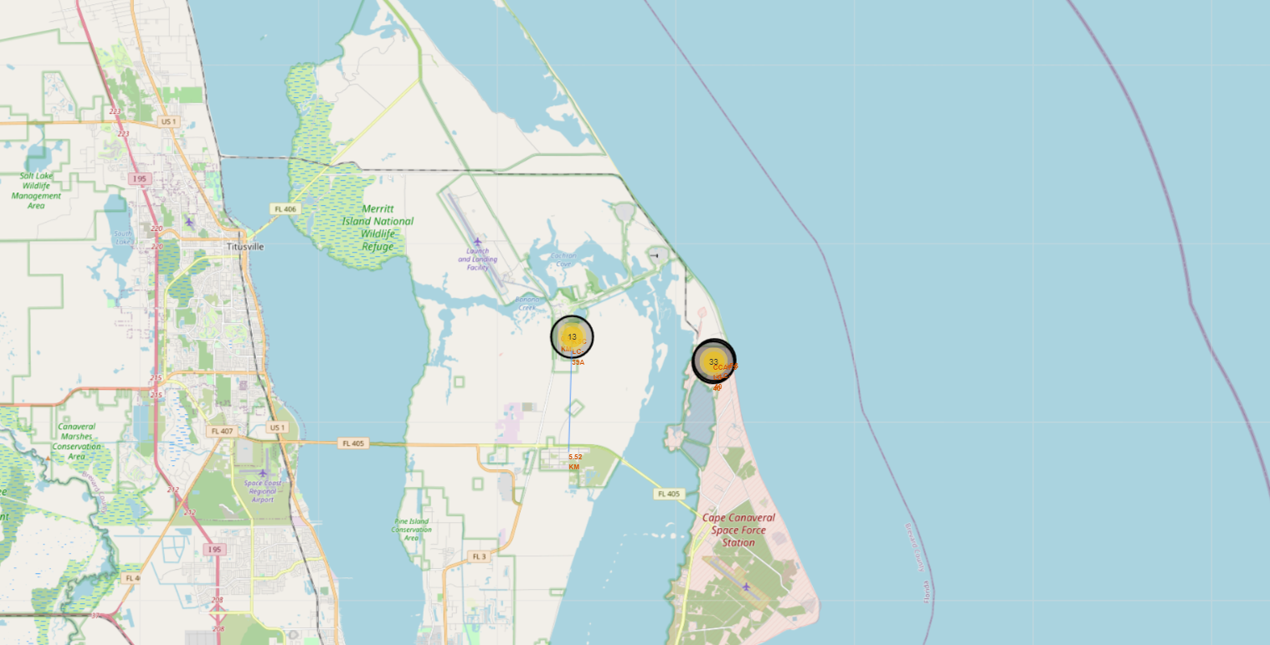
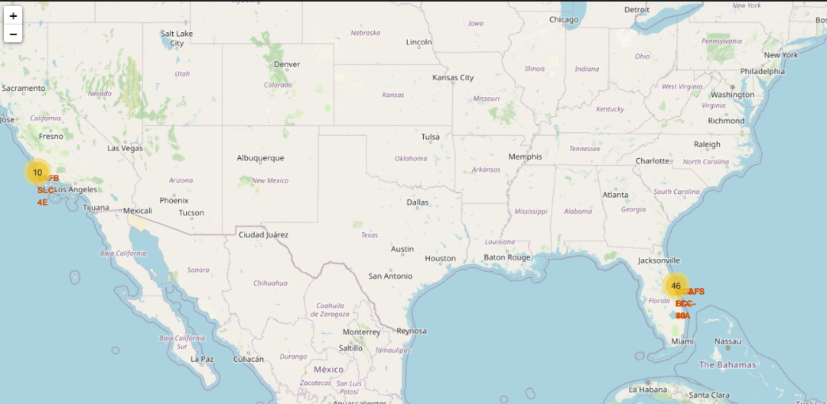
Results
Through interactive analytics, it was feasible to determine that launch sites are typically located in secure areas near bodies of water, with well-established logistical infrastructure nearby.
The majority of launches occur at launch sites located on the east coast.

Slide 19
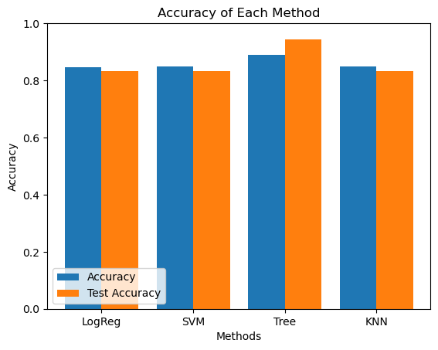
Results
According to the results of predictive analysis, the Decision Tree Classifier proved to be the most effective model in predicting successful landings, with an accuracy exceeding 87% and a test data accuracy of over 94%.The majority of launches occur at launch sites located on the east coast.

Slide 20

Section 2

Slide 21
Flight Number vs. Launch Site
Based on the above graph, it is evident that the most successful launch site presently is CCAF5 SLC 40, with the majority of recent launches achieving success.
Second place is occupied by VAFB SLC 4E, with KSC LC 39A coming in third.
The success rate, in general, has improved over time.

Slide 22
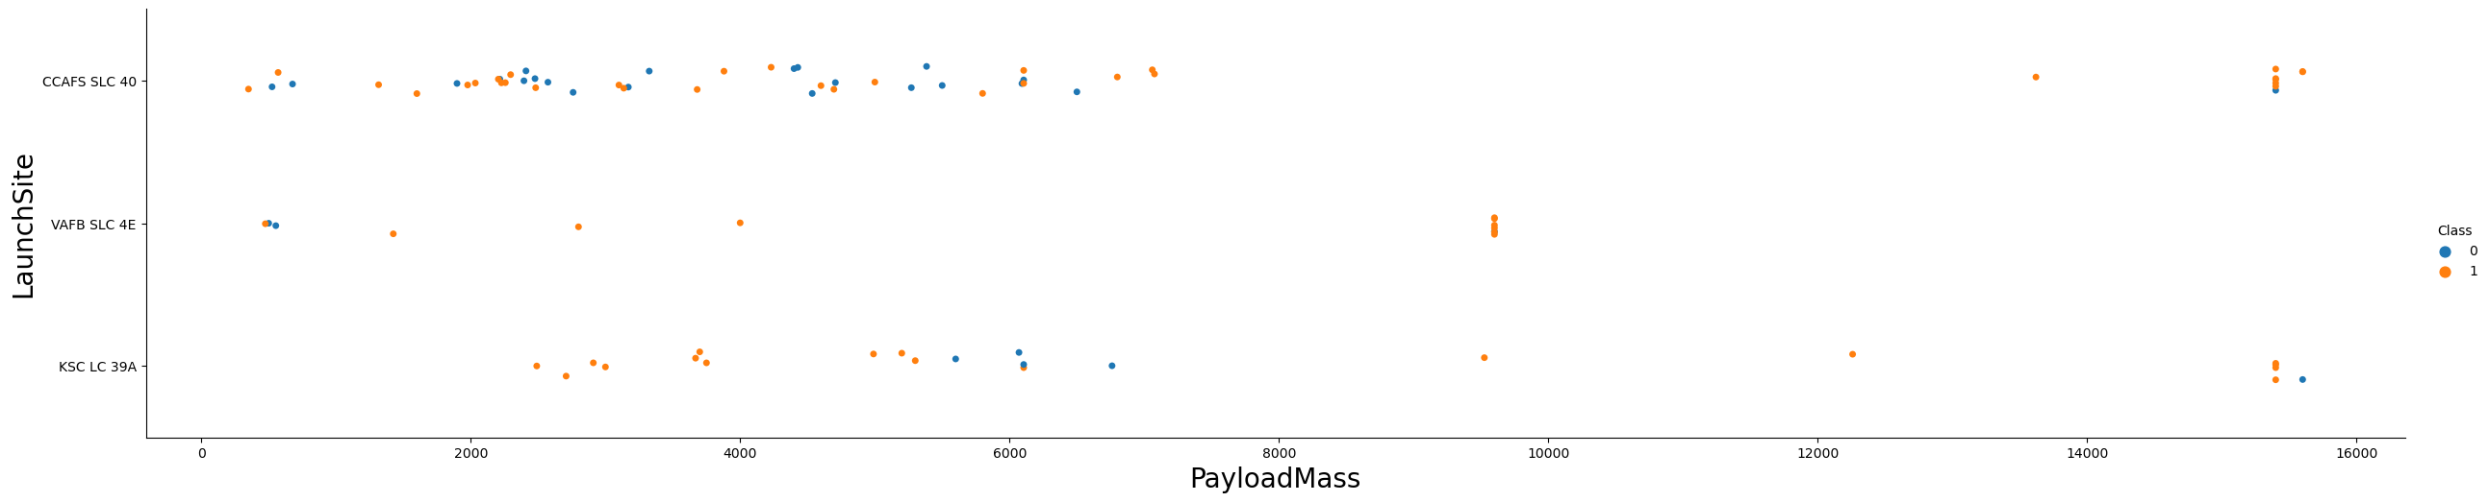
Payload vs. Launch Site
Payloads weighing more than 9,000kg, equivalent to the weight of a school bus, display an excellent success rate.
Only the CCAFS SLC 40 and KSC LC 39A launch sites appear capable of accommodating payloads exceeding 12,000kg.

Slide 23
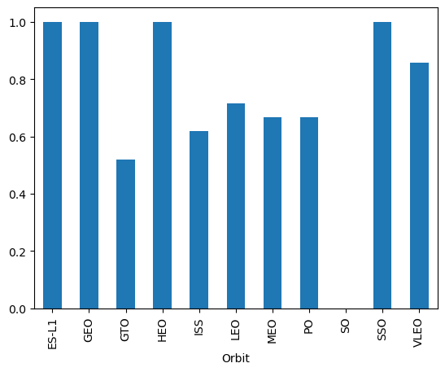
Success Rate vs. Orbit Type
The highest success rates are observed for the following orbits:
ES L1
GEO
HEO
SSO
The next most successful orbits are:
VLEO (above 80%); and
LFO (above 70%).

Slide 24
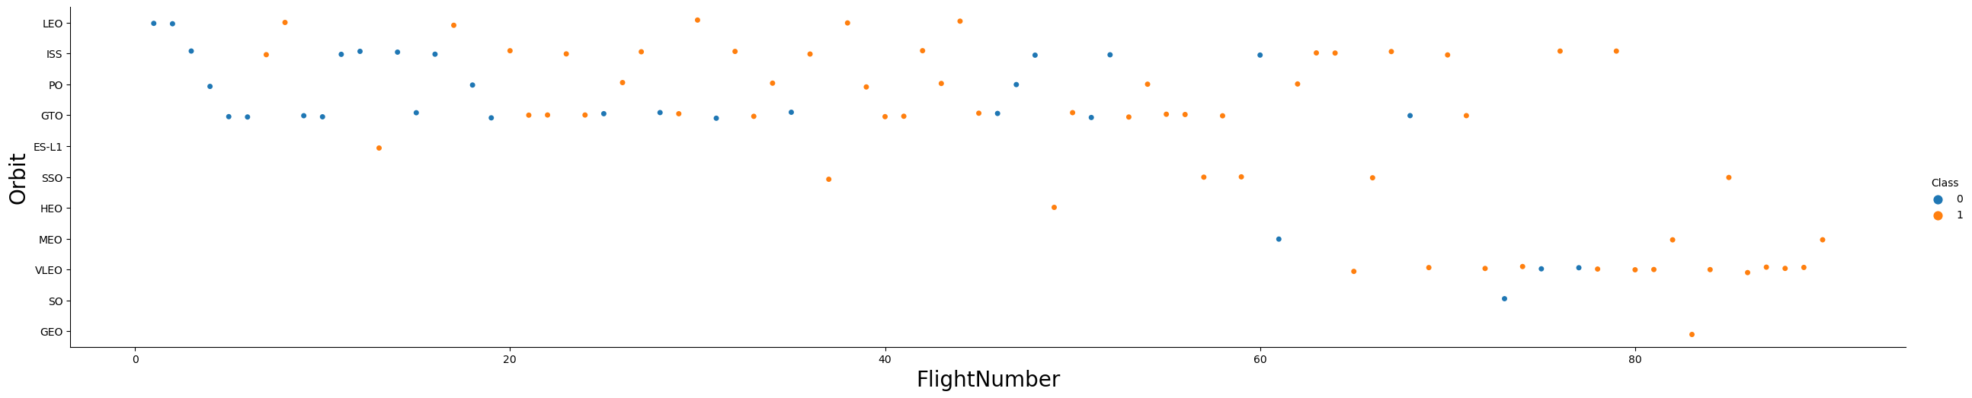
Flight Number vs. Orbit Type
Success rates have seemingly improved over time for all orbits.
The frequency of VLEO orbit launches has recently increased, indicating a potential new business opportunity.

Slide 25
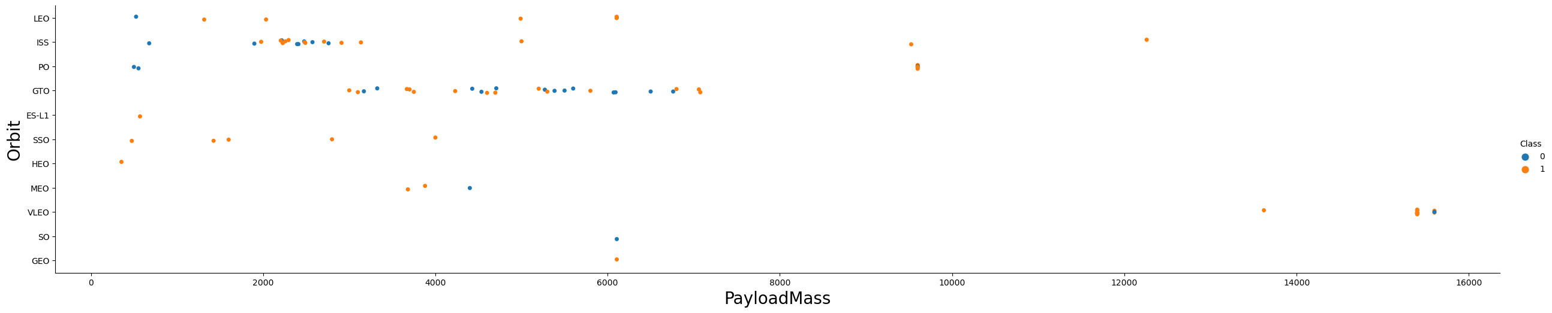
Payload vs. Orbit Type
There appears to be no correlation between payload and success rate for the GTO orbit.
The ISS orbit displays the broadest range of payloads and a commendable success rate.
Launches to the SO and GEO orbits are relatively infrequent.

Slide 26
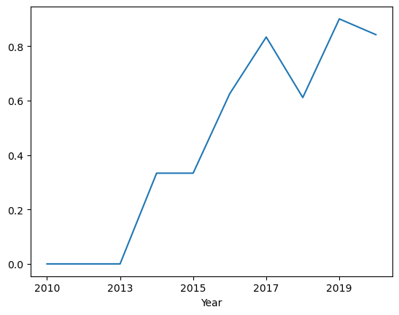
Launch Success Yearly Trend
The success rate has been on an upward trend since 2013 and persisted until 2020.
The initial three years appear to have been a period of adjustments and technological improvements.

Slide 27
All Launch Site Names
There are four launch sites, which are determined by selecting the unique instances of "launch_site" values from the dataset.
Launch site
CCAFS LC-40
CCAFS SLC-40
KSC LC-39A
VAFB SLC-4E

Slide 28
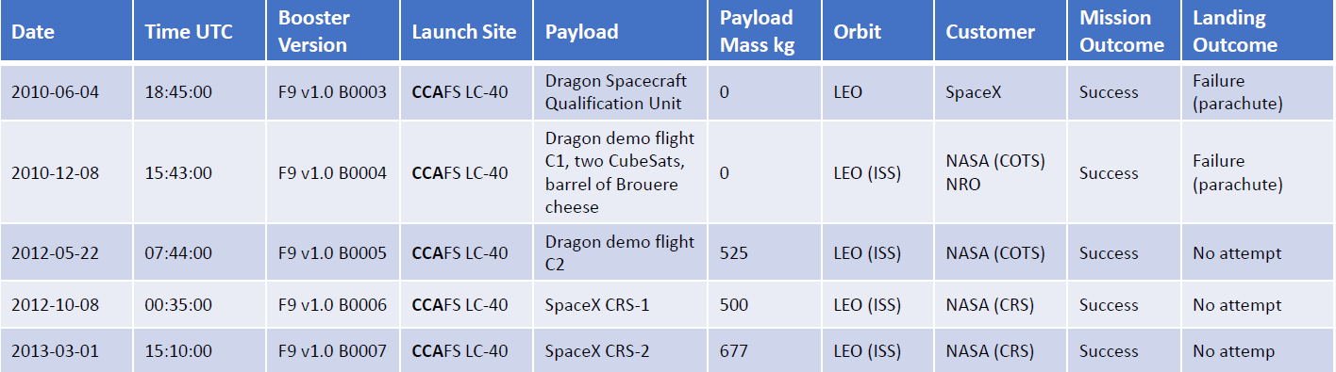
Launch Site Names Begin with 'CCA'
Find 5 records where launch sites begin with `CCA`
The following displays five examples of Cape Canaveral launches.

Slide 29
Total Payload Mass
The total payload transported by boosters from NASA:
Total Payload (kg)
111.268
The overall payload was calculated by summing the payloads associated with codes containing 'CRS', which correspond to NASA.

Slide 30
Average Payload Mass by F9 v1.1
Calculate the average payload mass carried by booster version F9 v1.1
Avg Payload (kg)
2928
After filtering the data to include only the specified booster version and calculating the average payload mass, it was determined to be 2,928 kg.

Slide 31
First Successful Ground Landing Date
Find the dates of the first successful landing outcome on ground pad
Min Date
22/12/2015
By filtering the data to include only successful landing outcomes on ground pads and identifying the minimum date value, the initial occurrence can be determined, which transpired on 22/12/2015

Slide 32
Successful Drone Ship Landing with Payload between 4000 and 6000
The boosters that have successfully landed on drone ships and had payload masses greater than 4000 but less than 6000.
Booster Version
F9 FT B1021.2
F9 FT B1031.2
F9 FT B1022
F9 FT B1026
After applying the aforementioned filters to select unique booster versions, the resulting count was 4.

Slide 33
Total Number of Successful and Failure Mission Outcomes
Calculate the total number of successful and failure mission outcomes
By grouping mission outcomes and tallying the corresponding number of records for each group, we arrived at the above summary.
Mission Outcome | Occurrences
Success | 99
Success (payload status unclear) | 1
Failure (in flight) | 1

Slide 34
Boosters Carried Maximum Payload
Boosters which have carried the maximum payload mass.
The following boosters transported the highest recorded payload masses in the dataset.
Booster Version
F9 B5 B1048.4
F9 B5 B1048.5
F9 B5 B1049.4
F9 B5 B1049.5
F9 B5 B1049.7
F9 B5 B1051.3
F9 B5 B1051.4
Booster Version
F9 B5 B1051.6
F9 B5 B1056.4
F9 B5 B1058.3
F9 B5 B1060.2
F9 B5 B1060.3

Slide 35
2015 Launch Records
The booster versions and launch site names associated with failed landing outcomes on drone ships during the year 2015.
BoosterVersion | LaunchSite
F9 v1.1 B1012 | CCAFS LC-40
F9 v1.1 B1015 | CCAFS LC-40

Slide 36
Rank Landing Outcomes Between 2010-06-04 and 2017-03-20
Ranking of landing outcomes from June 4, 2010, to March 20, 2017. This perspective on the data highlights the significance of taking "No attempt" into account
Landing Outcome | Occurrences
No attempt | 10
Failure (drone ship) | 5
Success (drone ship) | 5
Controlled(ocean) | 3
Success (ground pad) | 3
Failure (parachute) | 2
Uncontrolled (ocean) | 2
Precluded (drone ship) | 1

Slide 37

Section 3

Slide 38
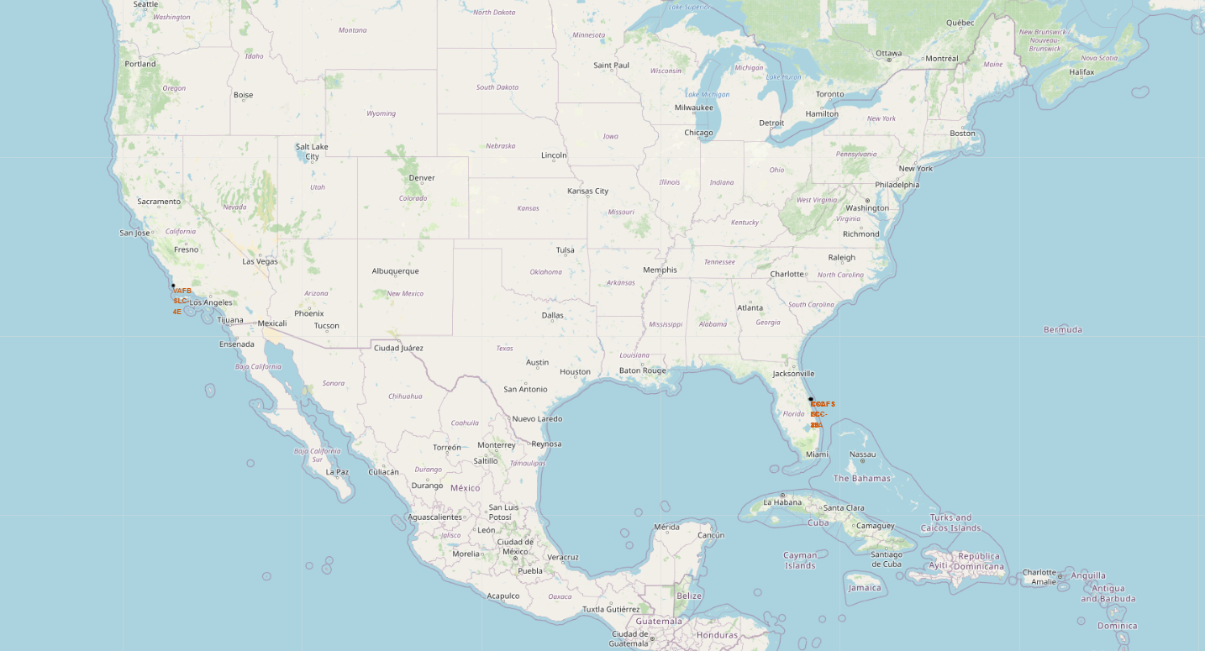
All launch sites
Launch sites are situated in close proximity to bodies of water, most likely for safety reasons, while remaining accessible via roads and railroads.

Slide 39
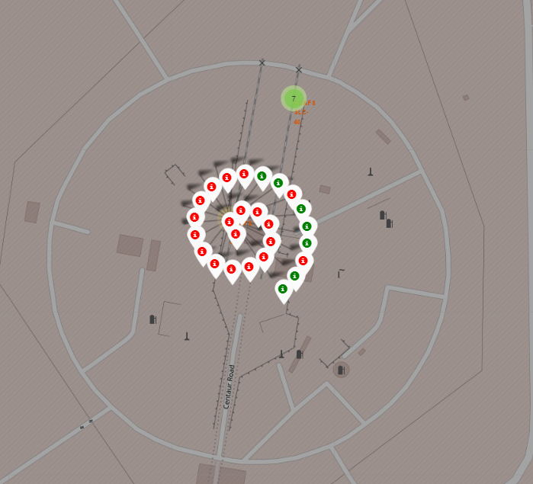
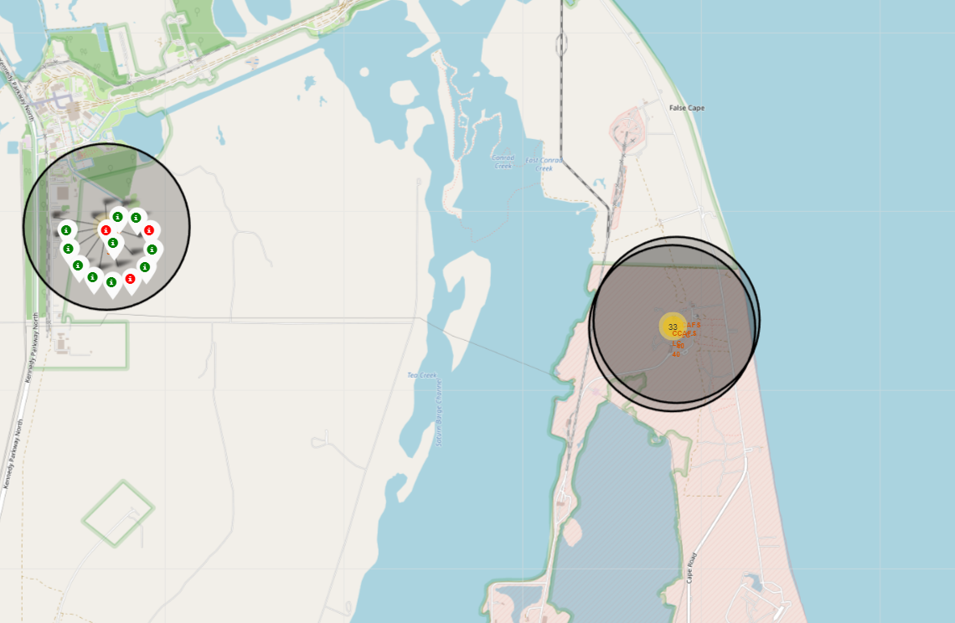
Launch Outcomes by Site
Example of launch site launch outcomes

Slide 40
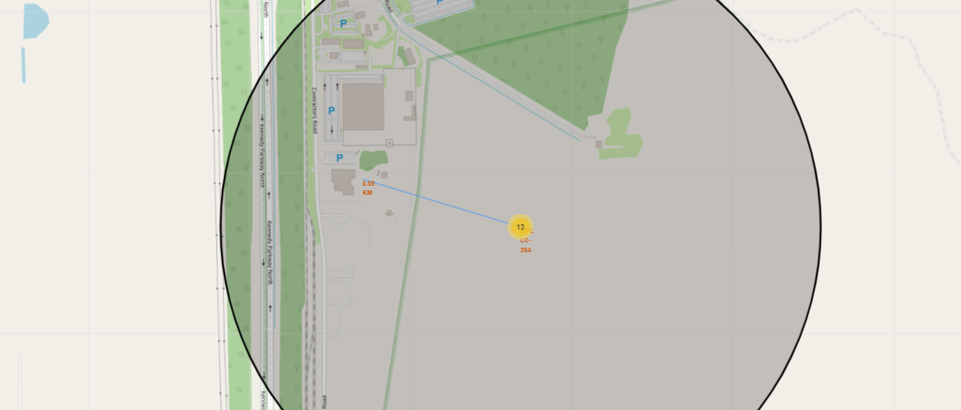
Launch Site Proximities: Analyzing Distances
KSC LC 39A benefits from excellent logistics, given its strategic location near both rail and road networks, while also being situated at a safe distance from residential areas.

Slide 41

Section 4

Slide 42
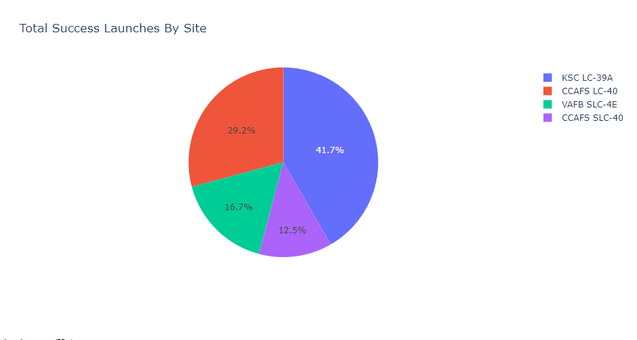
Achievement of Launch Sites
The launch site appears to be a crucial factor in the success of missions.

Slide 43
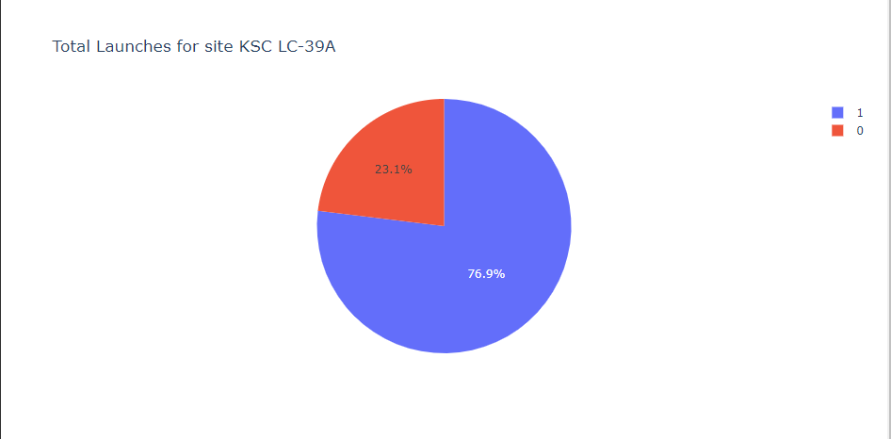
KSC LC 39A Launch Success
KSC LC 39A boasts a 76.9% success rate for launches.

Slide 44
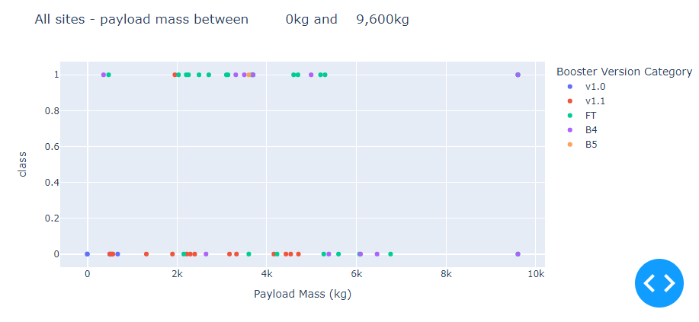
Relationship between Payload and Launch Result
The most successful combination appears to be payloads under 6,000kg paired with FT boosters.

Slide 45
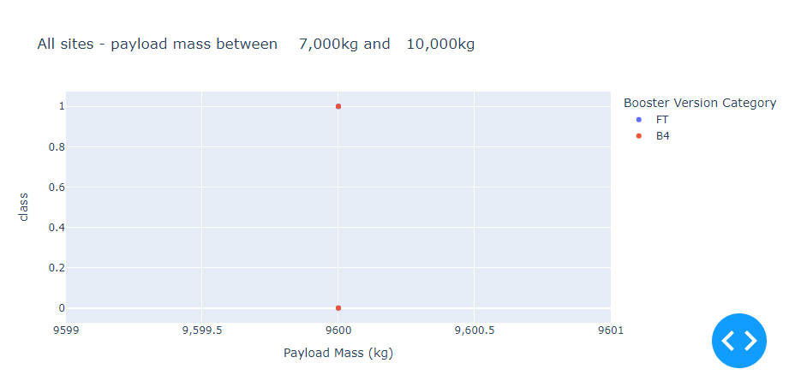
Relationship between Payload and Launch Result
Not enough data of huger than 7000 kg.

Slide 46

Section 5

Slide 47
Classification Accuracy
The accuracies of four classification models were tested and plotted. The Decision Tree Classifier emerged as the top-performing model, boasting accuracy levels exceeding 87%.

Slide 48
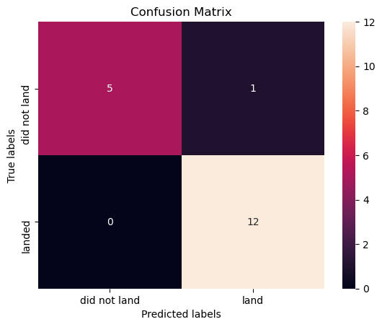
Confusion Matrix
The accuracy of the Decision Tree Classifier is supported by its confusion matrix, which demonstrates a high number of true positive and true negative values in comparison to false values.

Slide 49
Conclusions
Diverse data sources examined for improved insights
KSC LC 39A highlighted as best launch site
Payloads beyond 7,000 kg regarded as lower risk
Most mission outcomes found to be successful
Incremental enhancement in landing success rates attributed to advancements in technology and methods
Decision Tree Classifier deemed valuable for forecasting triumphant landings and boosting revenue

Slide 50
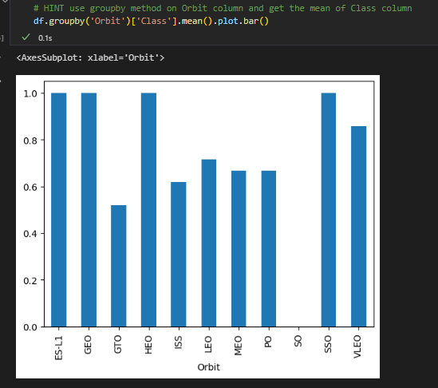
Appendix
Include any relevant assets like Python code snippets, SQL queries, charts, Notebook outputs, or data sets that you may have created during this project

Slide 51


